Slide 1
St10176153 P0e presentation 22/11/24 disd[2] grp[1]

Slide 2

Application overview

Slide 3
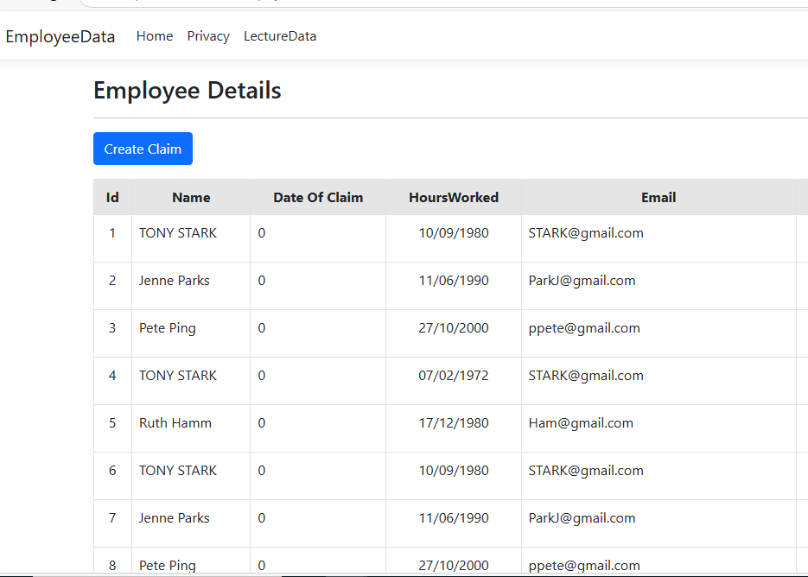
MANAGEMENT PAGE overview
This is an overview of the EmployeeDetails Page where it can be accessed by employee and Manager.
Employees can only Create Claim in the claims form page by clicking the Create Claim and view Pending Claims.
Managers can access the claims form for approval or rejection

Slide 4
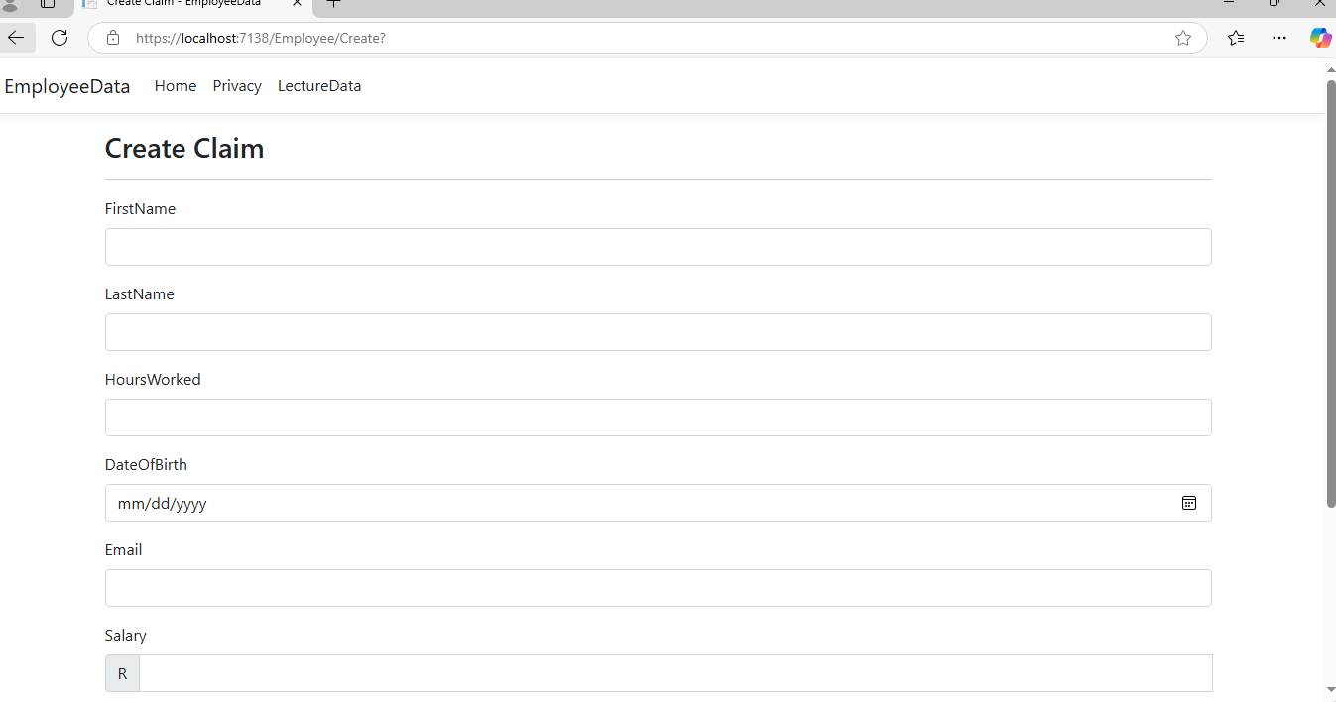
Create claims form:
Lecturers can submit claims for hours worked, upload supporting documents, and add additional notes.
Steps:
1. Navigate to the Submit Claim page from the home page.
2. Fill in the claim form with the required details, including:
⦁ Hours Worked
⦁ Salary
⦁ Additional Notes
3. Upload supporting documents (PDF, DOC, JPEG) using the upload button.
4. Click Submit Claim to submit your claim. A confirmation page will appear once the claim is successfully submitted.

Slide 5
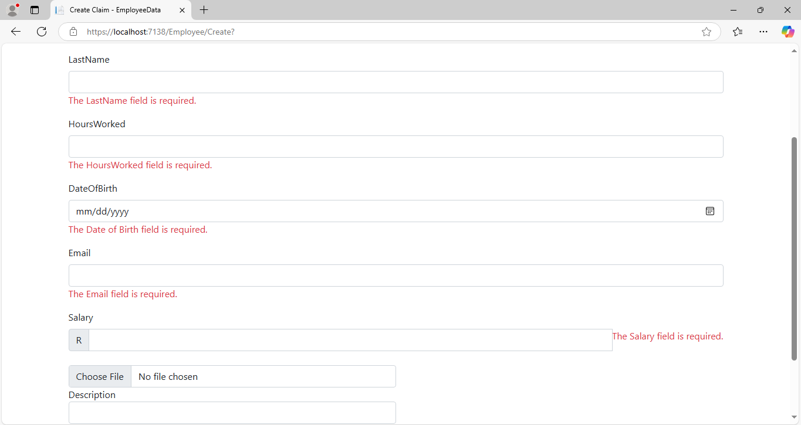
Error handling:
As requiredthe fields have been made important and they mut be field for the claim to be logged.
If the fields have not been filled the claim will not be successfuol and it will be processed.
If an error occurs during claim submission or approval, meaningful error messages will be displayed. For example:
•File size or type error during file upload.
•Database connection error.
•Validation error for incomplete forms.

Slide 6
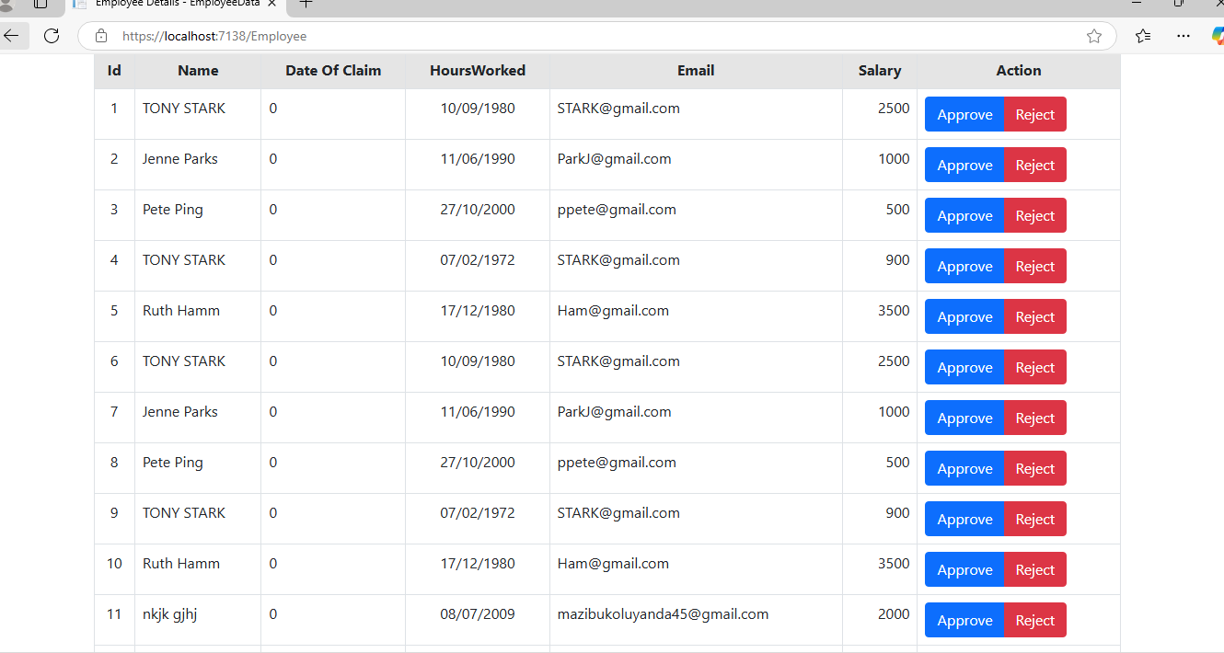
Claims Page:
After submitting claims, lecturers can view the status of their submitted claims.
Steps:
1. Navigate to the Claims page.
2. You will see a list of all your claims, including:
•Date Submitted
•Hours Worked
•Salary
•Status (Approved, Deleted)
Both lecturers and managers can track the real-time status of claims.
•Approved: The claim has been approved by a Programme Coordinator or Academic Manager.
•Delete: The claim has been rejected.

Slide 7
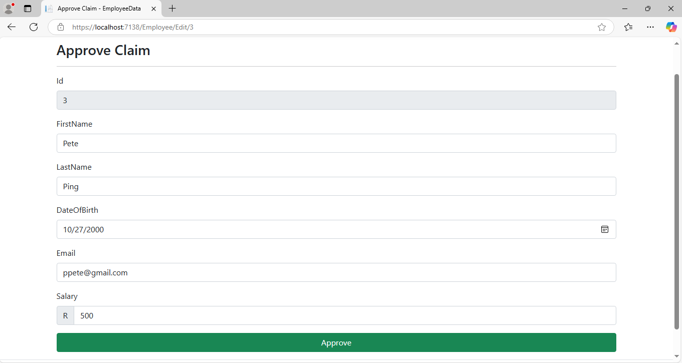
Approval page:
Feb 20XX: roll out product to high profile or top-level participants to help establish the product
May 20XX: release the product to the public and monitor press release and social media accounts
Oct 20XX: gather feedback and adjust product design as necessary

Slide 8

Thank you

